Slide 1
Pens & Printers
A National chain
Do we have unsold products in any of our 4 Warehouses?

Slide 2
Stale Inventory
1,854 Unique Products sold 2014-2017
 | % unique products sold in only 1 location | % unique products sold in only 2 locations | % unique products sold only in 3 locations | Total % not sold in all locations
All | 9% | 24% | 41% | 74%
Furniture | 1% | 5% | 9% | 15%
Office Supplies | 4% | 13% | 24% | 41%
Technology | 3% | 7% | 8% | 18%
Next Step: Perform a product rationalization; deeper analysis is required to determine product per location strategy.

Slide 3
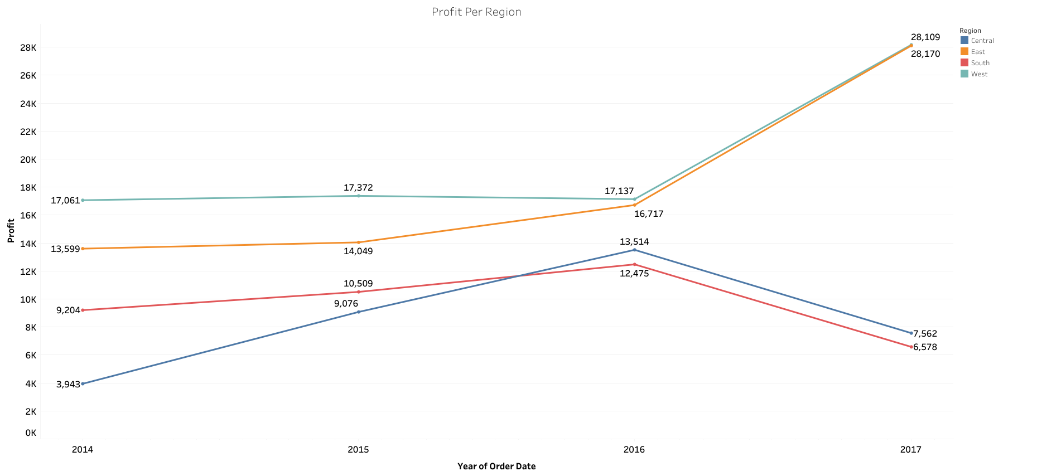
Profit Disparity Across Regions
Business Question: What is causing profit disparity between East/West and South/Central

Slide 4
Central Region Discounts
Pre-Discount Profit
Quality and Quantity of discounts in the Central Region
Discounted Revenue
Realized Profit
Binders
Furnishings
Machines
 | Profit / Loss | Central avg Discount % | East / West avg discount %
Binders | -71 | 50% | 35%/28%
Furnishings | -2,634 | 40% | 8%/3%
Machines | -1,533 | 33% | 28%/30%
Appliances | -2,272 | 30% | 15%/12%
Tables | -2,808 | 26% | 37%/20%
$7,300
$13,500
$10,000
$15,000
$54,000
$54,200
-$70
-$2,600
-$1,600
Next Step: Align discount amount across regions to ensure profitability or eliminate sales of at loss products.

Slide 5
South Region Discounts
Pre-Discount Profit
Discounted Revenue
Quality and Quantity of discounts in the South Region
Realized Profit
Binders
Tables
Machines
 | Profit / Loss | South avg Discount % | East / West avg discount %
Binders | $2,200 | 37%% | 35%/28%
Tables | -$1,000 | 22% | 37%/20%
Machines | -$4,200 | 33% | 28%/30%
$14,00
$33,700
$15,000
$38,000
$26,600
$29,000
$2,200
-$1,000
-$4,200
Next Step: Align discount amount across regions to ensure profitability or eliminate sales of at loss products.

Slide 6
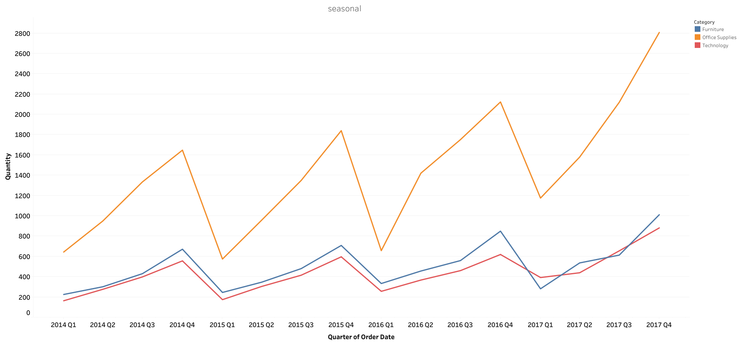
Seasonal
Next Step: Assess by region seasonal stocking needs based on procurement availability, cost to store goods, and warehouse space availability to develop more cost-effective stocking strategies.

Slide 7
Recommendations
Rationalize available products by region
74% of all products are not sold at all four location therefore action needs to be taken to reduce warehousing costs of goods that do not sell at each region.
Standardize national discount strategy
Central and south are losing profit due to discounts and as proven in east and west customers are more tolerant of lower discount thresholds.
Implement seasonal based stocking
Sales trends show seasonal trends in demand exist. Procurement and internal cost data is required to develop detailed action plans.

